Slide 1
Writing a Plugin
Submitted to ,
Dr Kanika Goel

Slide 2
WordPress Plugins
modify, customize, and enhance a WordPress site.
add functionality Instead of changing the core program code of WordPress.
WordPress Plugin is a program or a set of one or more functions
written in the PHP
https://codex.wordpress.org/Writing_a_Plugin

Slide 3
How php works
<? Open tag
?> close tag
Server side scripting language-php is executed in server-code run first
Can Embed php in html
Create dynamic pages
Eg. Fb –sign up ,post ,status,join group , -related to forms
first process php code, before displaying something to the browser

Slide 4
<?php
Echo hi I am a php script
?>
Ability to use with forms

Slide 5
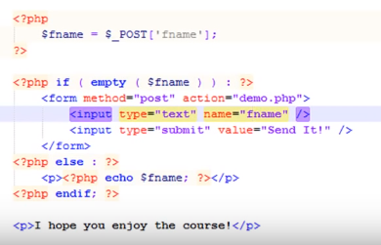

Slide 6
Plugin development
what the Plugin will do
choose a unique (better)name for your Plugin.
wp-content/plugins/
must have at least one PHP file
create a readme.txt file
could also contain JavaScript files, CSS files, image files and language files.
Install and Activate plugin

Slide 7
Actions
triggered by specific events that take place in WordPress
Modify database data.
Send an email message.
Modify the generated administration screen or front-end page sent to a user browser.
WordPress Plugin Hooks-
add action(‘shebinsays’, ’run’) #hook and the function
add_action ( 'hook_name', 'your_function_name', [priority], [accepted_args] );

Slide 8
if you want your friends to get an email message whenever you create a new post
function email_friends($post_ID) {
$friends = 'bob@example.org,susie@example.org';
mail($friends, "sally's blog updated",
'I just put something on my blog: http://blog.example.com');
return $post_ID;
}
add_action ( 'publish_post', 'email_friends' );
Avoiding Function Name Collisions

Slide 9
Filters
functions that WordPress passes data through, at certain points in execution, just before taking some action with the data
Create the PHP function that filters the data.
Hook to the filter in WordPress, by calling add_filter().
Put your PHP function in a plugin file, and activate it
A filter function takes as input the unmodified data, and returns modified data

Slide 10
Example
if you want to make sure that your posts and comments contain no profanity, you might define a variable with a list of forbidden words, and then create the following PHP function:
function filter_profanity( $content ) {
$profanities = array('badword','alsobad','...');
$content = str_ireplace( $profanities, '{censored}', $content );
return $content;
}
add_filter ( 'hook_name', 'your_filter', [priority], [accepted_args] );

Slide 11
Developing from Scratch
Just one php file is enough.
Form
add shortcode
Left hand menu option
Header and footer scripts,update option,form1
Form to add feedback
Capturing it and mail it after filtering
Show the form in comment
Add the feedback into database

Slide 12
Let’s go live
Presentation with code

Slide 13
Thank You

